Slide 1
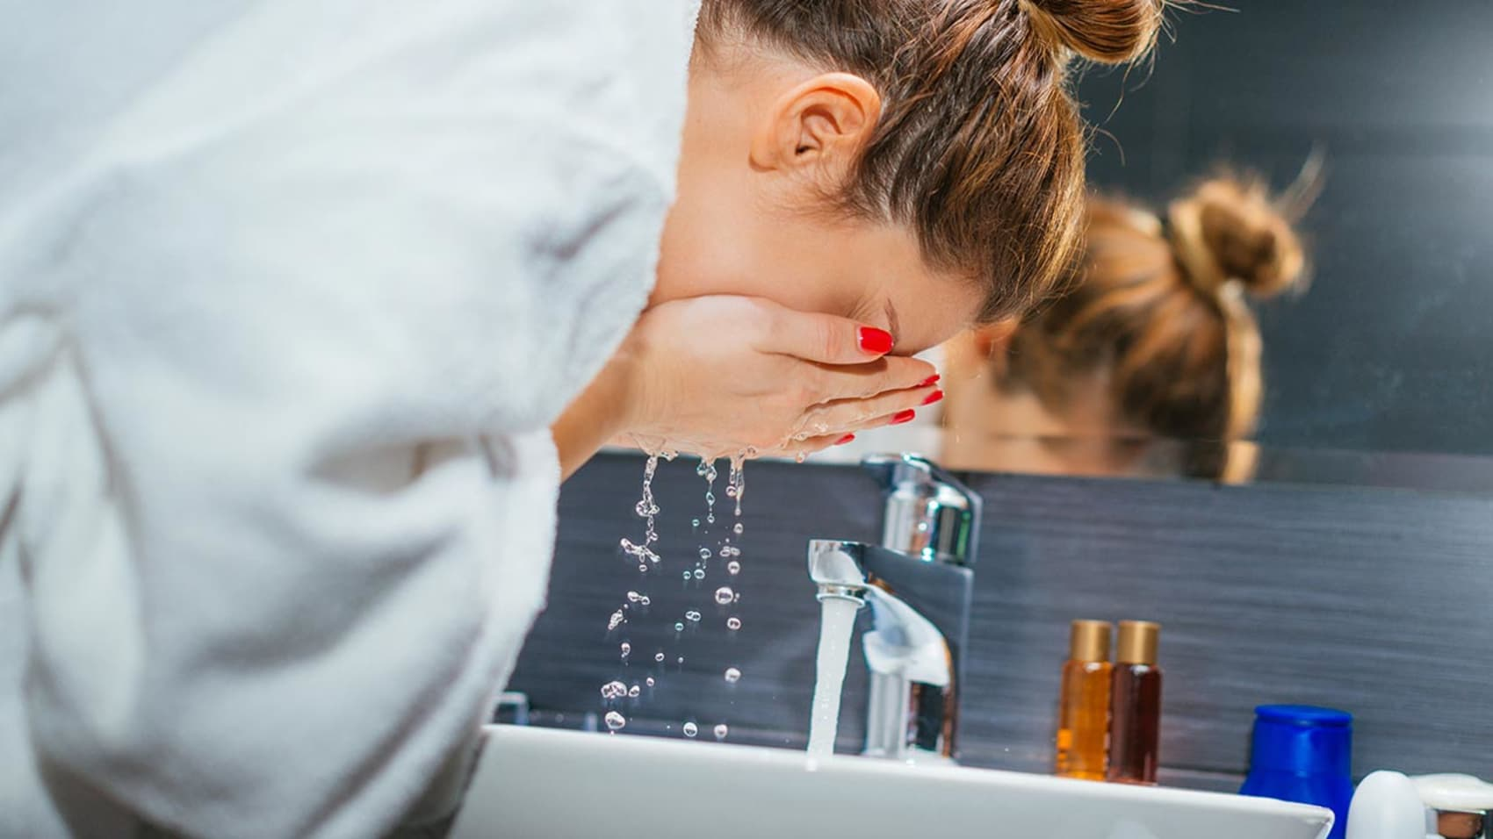

Is that really what you want?
Web Scraping lorealparisusa.com
Notes:
更多模板请关注：https://haosc.taobao.com

Slide 2
01
Company Overview
CONTENT
02
Research Topic & Data
03
Findings
04
Conclusion & Future Work
Notes:
更多模板请关注：https://haosc.taobao.com

Slide 3
Part 01
Company Overview
PART 01

Slide 4
Company Overview
French personal care
The largest cosmetic company
- Skin Care
- Makeup
- Hair Care
- Perfume

Slide 5
Part 02
Research Topic & Data
PART 01

Slide 6
Research Topic
Consumers tend to choose products with good reviews. Are those products suitable for them?

Slide 7
Products Data
Category
Price
Rating
Reviews Data
Rating
Content
Age
Hair Color
Eye Color
Undertone
Data

Slide 8
Part 03
Findings & Result
PART 01

Slide 9
Products Data
Price Distribution
Rating Distribution
What are the Top Products for each category?

Slide 10
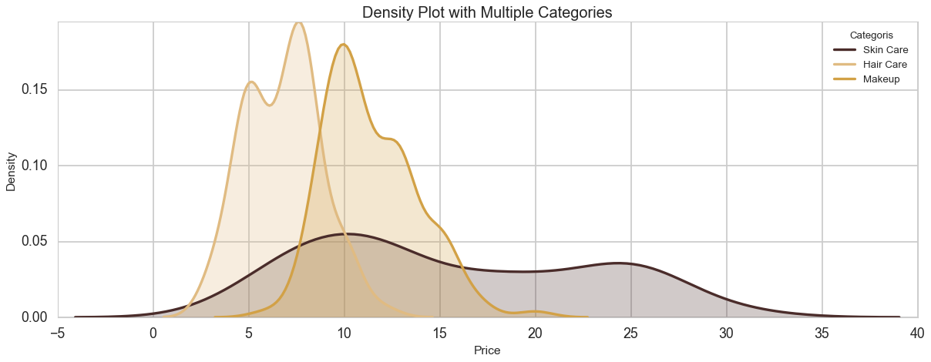
Products Data
Price Density Plot with Multiple Categories
Hair Care
Makeup
Density
Skin Care
Price

Slide 11
Products Data
Rating Density Plot with Multiple Categories
Density
Rating

Slide 12
Top Products in Each Category
Main Category | Category | Product Name | Num of Reviews | Price | Rating Score
Hair Care | Conditioner | Extraordinary Oil Conditioner | 2349 | 4.99 | 4.8
Hair Care | Shampoo | Extraordinary Oil Shampoo | 3279 | 4.99 | 4.7
Hair Care | Hair Treatments | Extraordinary Oil-In-Cream | 1601 | 6.99 | 4.7
Makeup | Mascara | Lash Primer | 1699 | 8.95 | 4.5
Makeup | Lipstick | Matte Lip Stain | 6787 | 11.99 | 4.4
Makeup | Foundation Makeup | Total Cover Foundation | 1852 | 12.99 | 4.2
Skin Care | Facial Cleanser | Bright Reveal Brightening Daily Scrub Cleanser | 2649 | 6.99 | 4.6
Skin Care | Face Mask | Exfoliate & Refining Face Mask | 1993 | 12.99 | 4.6
Skin Care | Facial Moisturizer | 1.5% Pure Hyaluronic Acid Serum | 1722 | 29.99 | 4.5

Slide 13
Reviews Data
Matte Lip Stain
Age
Undertone
Hair Color
Eye Color

Slide 14
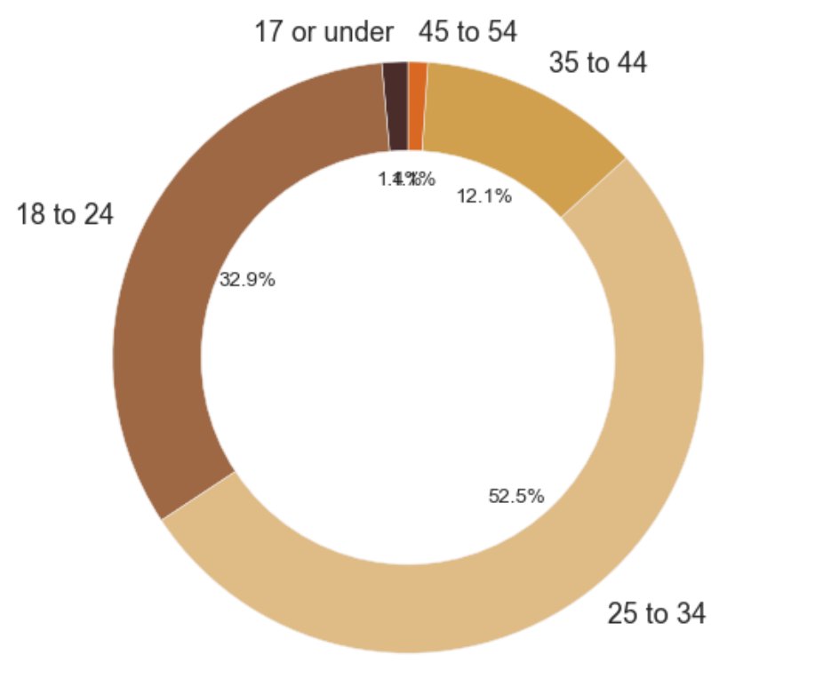
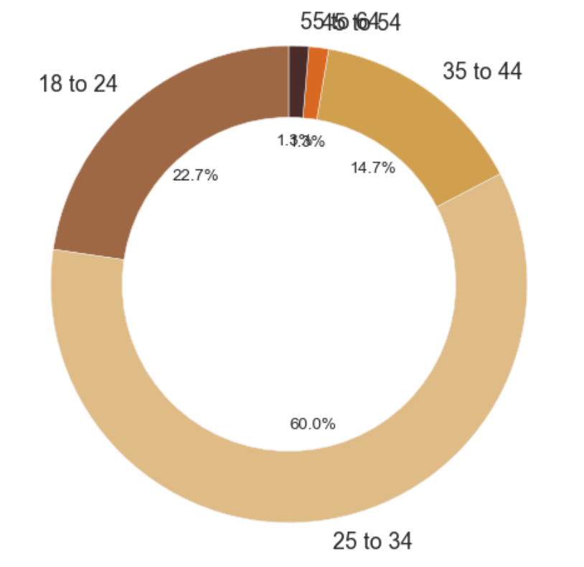
Reviews Data
Age Distribution for Good/Bad Reviews
18-24
18-24
22.7%
32.9%
25-34
25-34
52.5%
60.0%

Slide 15
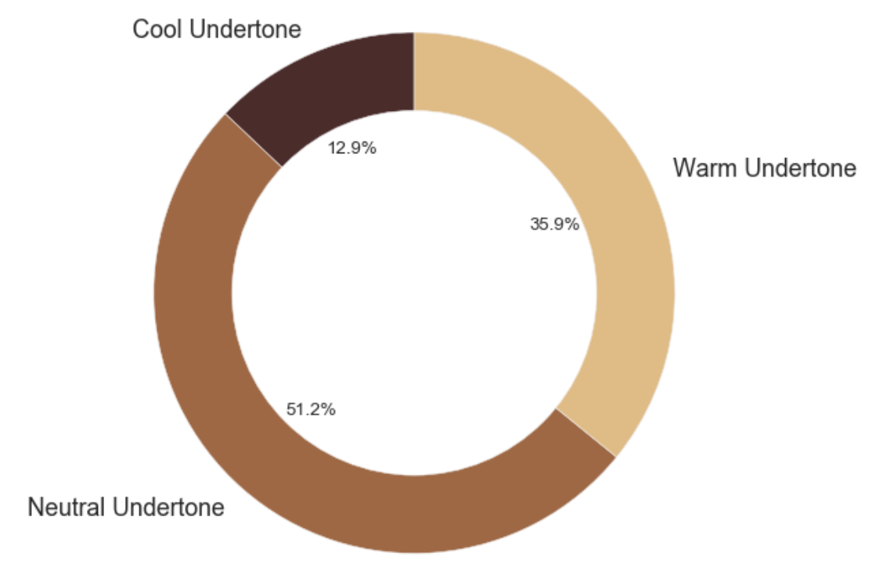
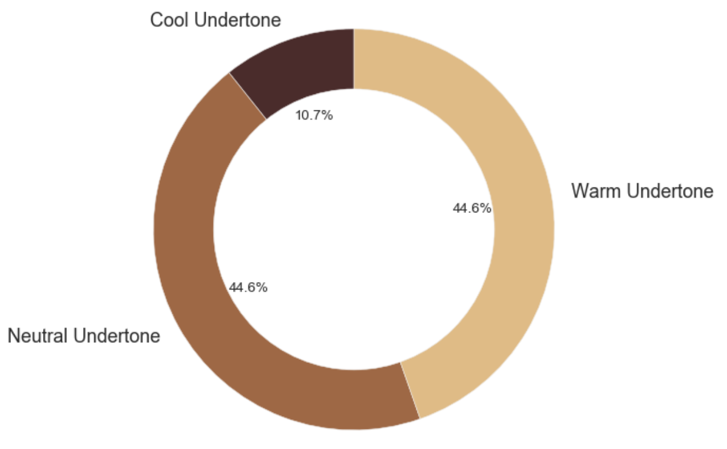
Reviews Data
Undertone Distribution for Good/Bad Reviews
Warm
Undertone
Warm
Undertone
35.9%
44.6%
44.6%
Neutral
Undertone
51.2%
Neutral
Undertone

Slide 16
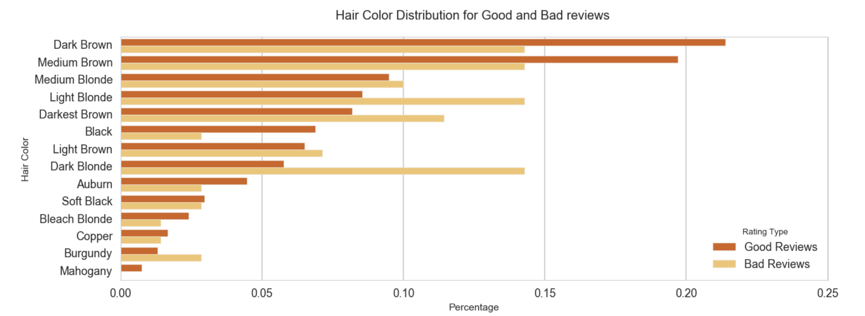
Reviews Data
Hair Color
Hair Distribution for Good/Bad Reviews
Good Reviews
Bad Reviews
Percentage

Slide 17
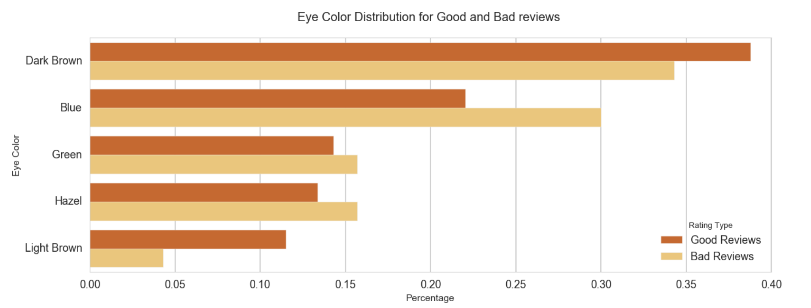
Reviews Data
Eye Color
Eye Color Distribution for Good/Bad Reviews
Good Reviews
Bad Reviews
Percentage

Slide 18
Word Cloud

Slide 19
Part 04
Conclusion & Future Work
PART 01

Slide 20
Conclusion & Future Work
L’OREAL’s Matte Lip Stain would be more suitable for consumers who are:
18-24 years old
neutral undertone
dark brown/medium brown/black hair
brown eyes
This kind of analysis can be applied to any product

Slide 21
Thanks for watching

